Slide 1

RealEase: Comprehensive Real Estate Insights Platform
Milestone 4 Overview
By Donovan Murphy, Jonathan Bailey, and Enrique Obregon

Slide 2
Milestone Overview
Individual Home Card Refresh
DB Schema Improvements
ROI Tool Implementation
Home Comparison Layout

Slide 3
Milestone Three Plan
Task | Completion % | Donovan | Jonathan | Enrique | To Do
ROI Tool | 85% | 20% | 60% | 20% | Implement logic into frontend and figure out how to pull information from house instead of having the user enter it all
Investigate JavaScript functions and card layout on the home screen | 95% | 50% | 10% | 30% | Fully implemented, continue refining UI/UX based on testing feedback
Working Website Demos | 80% | 33% | 33% | 33% | Add a Neighborhood Insight Demo, refine UI consistency
House Comparison Tool | 90% | 30% | 10% | 60% | Improve design if needed and further logic of comparison
Flask + MERN stack & caching/geolocating users | 20% | 70% | 15% | 15% | Implement caching methodology and determine feasibility of user location feature

Slide 4
Task 1: Frontend Development and Home Comparison Tool
Enhanced the frontend with Map functionality and ROI Integration
Began testing and implementing the house scoring algorithm

Slide 5
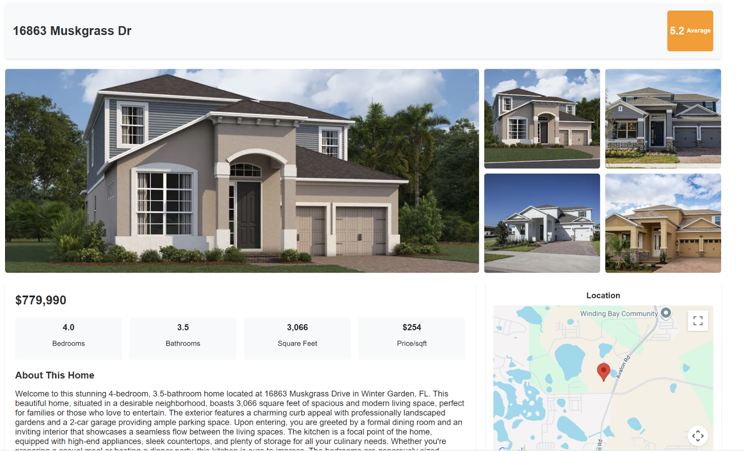
Task 1: Demo Image

Slide 6
Task 2: ROI Tool
Integrated the ROI tool with existing house data to limit the amount of data the user must enter
Implemented a dynamic ROI calculator on each individual house page

Slide 7
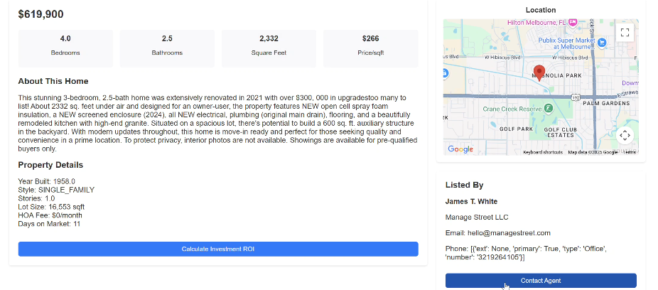
Task 2: ROI Tool Demo Image

Slide 8
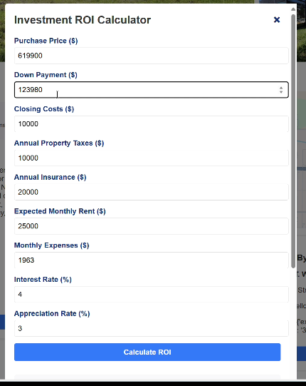
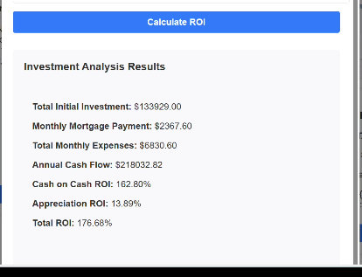
Task 2: ROI Tool Demo Results Image

Slide 9


Task 3: MERN Stack with Flask
Leveraging Python with the MERN stack to enhance the Neighborhood Insights Dashboard.
Implementing dynamic graphs and charts instead of static images for better interactivity.
Successfully implemented Flask backend, enhancing functionality and performance.
Improved house scoring algorithm and optimized search latency by refining our Python query script.

Slide 10
Task 4: API Research & Testing
Bring API Neighborhood data to the front end in graphical form using JavaScript.
Continue to refine our Homeharvest search and investigate lazy loading

Slide 11
Milestone Five Plan
Task | Donovan | Jonathan | Enrique
1. Finalize caching implementation & optimize user location tracking | implement/test 40% | Research 20% | Research/implement 40%
2. Continue to develop and begin testing of Neighborhood Insights Tool | Design 50% | Design 25% | Design 25%
3. Finalize ROI tool & improve frontend styling | Implement 40% | Implement 30% | Implement 30%

Slide 12
Task 1: Research and Begin Development on our Loading Method and Caching Searches
Integrate location tracking to display relevant property listings based on a user's geolocation
Improve speed and efficiency

Slide 13
Task 2: Neighborhood Insights Tool Development/Integration
Incorporate the API data we are getting for crime rates, school ratings, and local business information for each user location query (zip code) to the front end
Thoughtful UI presentation to ensure a seamless user experience

Slide 14
Task 3: Finalizing ROI Tool and Continued Frontend Upgrades
Require less manual entry
Revisit how we Clean Data before going into the frontend cards.

Slide 15
Faculty Advisor Feedback
Guidance on Data Retrieval Planning
Emphasis on unified data pull strategies to maintain performance.
Demo Development:
Iterative improvement based on client feedback to enhance user experience.
Caching and Lazy Loading
Focus on reducing latency to retain user engagement.

Slide 16

Questions?

